Slide 1
A Path Defense Approach to the Multiplayer Reach-Avoid Game
Mo Chen, UC Berkeley
Zhengyuan Zhou, Stanford University
Claire J. Tomlin, UC Berkeley
Dec. 16, 2014
Notes:
Hi everyone, thanks for coming to my talk. I’ll be talking about a path defense approach to the multiplayer reach-avoid game. I’m Mo Chen, and this work is done in collaboration with Zhengyuan Zhou from Stanford, and my advisor at UC Berkeley, Claire Tomlin.
Our work is not exact on linear systems, but we do show a way to analyze a very complex problem by performing two stages of approximations.

Slide 2
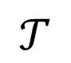
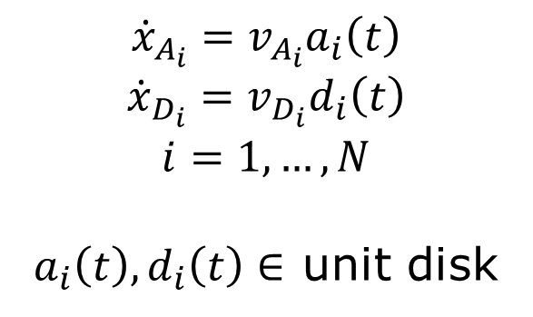
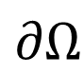
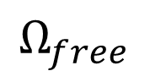
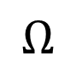

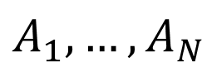

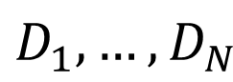
Multiplayer Reach-Avoid Game
Target
obstacle
defender
attacker
$$∂Ω$$
$$Ω_{free}$$
$$D_{1},…,D_{N}$$
$$Ω_{obs}$$
$$Ω$$
$$𝒯$$
$$A_{1},…,A_{N}$$
$$Ω_{obs}$$
$${\dot{x}}_{A_{i}}=v_{A_{i}}a_{i}\left(t\right)$$
$${\dot{x}}_{D_{i}}=v_{D_{i}}d_{i}\left(t\right)$$
$$i=1,…,N$$
$a_{i}\left(t\right),d_{i}\left(t\right)∈$ unit disk
Notes:
The multiplayer reach-avoid game is a game between two opposing teams of cooperative players playing on a compact 2D domain with obstacles. The attackers, shown as red crosses and labeled A1 to AN, aim to reach some target set shown in green. The defenders D1 to DN shown as blue stars aim to prevent the attackers from doing so by either capturing them or indefinitely delaying them. Each player has simple dynamics where they can move at up to some maximum speed in any direction.

Slide 3
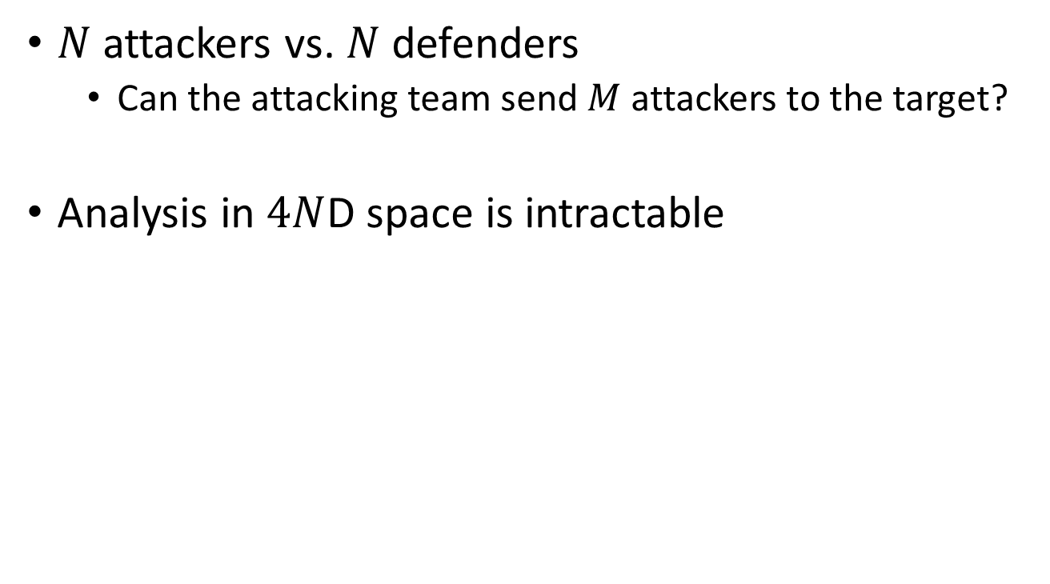
Multiplayer Reach-Avoid Game
$N$ attackers vs. $N$ defenders
Can the attacking team send $M$ attackers to the target?
Analysis in $4N$D space is intractable
Notes:
In this N vs N game, we’d like to ask how many attackers can reach the target. Since there are 2N players in the game, each with a 2D state space, the joint state space of all the players is 4N dimensional. Traditional dynamic programming involves deriving a corresponding HJI PDE, and then gridding up the joint state space, and thus its complexity scales exponentially with the number of dimensions. Therefore, this approach becomes computationally intractable.

Slide 4
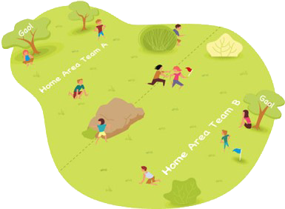
Motivation
High dimensionality: difficult to analyze
Difficult to intuit
Humans sometimes play suboptimally even in a 1 vs. 1 capture-the-flag game¹
Cooperation / Asymmetry
Applications in robotics and aircraft safety
¹Huang et al. 2011
Notes:
Multi-agent systems are difficult to analyze due to their inherent high dimensionality, as we have seen. The behavior of these systems is also difficult to intuit: in the popular game capture-the-flag, humans sometimes play suboptimally even in the simple 1 vs. 1 situation. Multi-vehicle systems also often involve aspects of cooperation and asymmetric goals among the vehicles or teams of vehicles, making their analysis interesting and difficult.
Despite these difficulties, it is still important to analyze multi-agent autonomous systems because of their applications in robotics and aircraft safety. Because these systems are safe-critical, game theory is a natural framework for analyzing these systems, as we must be able to consider the worst case disturbance.

Slide 5
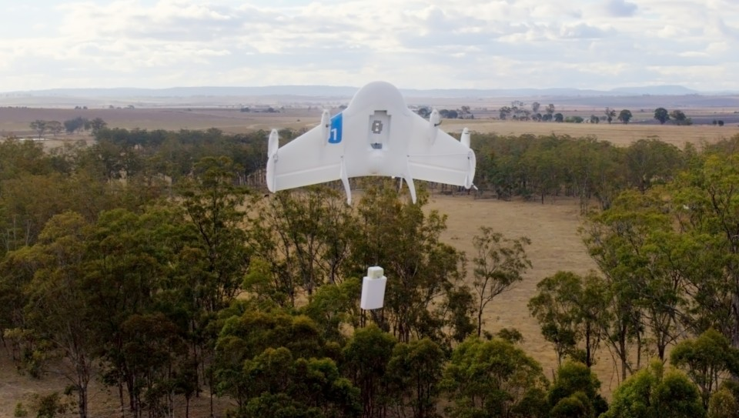
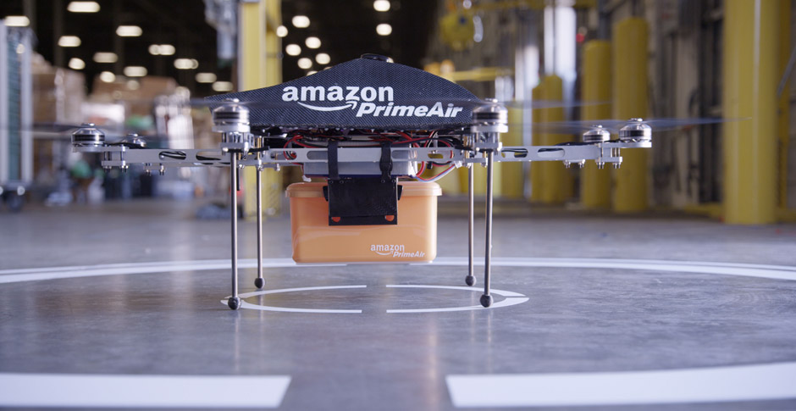
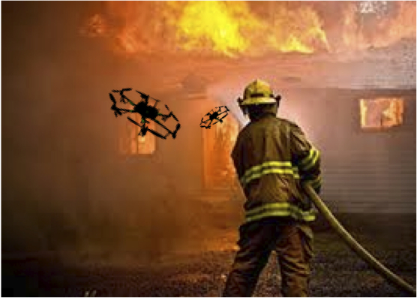
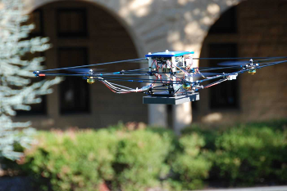

Motivation
Google Project Wing
Amazon Prime Air
Emergency Supply Delivery
Urban Fire fighting [NCSU]
Notes:
There are many practical applications that can be analyzed in a game-theoretic framework. For example, there has been a growing interest in using UAVs for civil applications, as companies like Amazon and Google are looking in the near future to send unmanned aerial vehicles into the airspace to deliver packages. Because of this, government agencies such as NASA and the FAA are also very interested in analyzing these problems in order to prevent conflicts in the airspace with the introduction of potentially many UAVs in an urban environment.
UAVs can be used not only to deliver packages quickly, but in any situation where fast response is desired. For example, this quadrotor by San Jose state university is designed to provide emergency supplies to disaster-struck areas that are otherwise difficult to reach. In addition, UAVs could potentially be used for fire fighting.

Slide 6
Outline
Multiplayer reach-avoid game^{1,2}
Relaxation of the two-player reach-avoid game via path defense
Graph theoretic approach to tie together unit problems²
¹Huang et al. 2011
²Chen, Zhou, Tomlin ACC 2014
Notes:
Outline: I will first briefly revisit the multiplayer reach-avoid game, and look at a special case of the two-player game, which is considered to be the unit problem. I will then show a relaxation of the unit problem in order to substantially reduce computation time by performing computations in a lower dimensional space.
Finally, I will describe how to approximate the solution to the multiplayer reach-avoid game by tying together the solution to the two-player reach-avoid game.

Slide 7
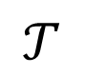
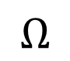
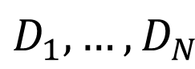
Multiplayer Reach-Avoid Game
Target
obstacle
defender
attacker
$$∂Ω$$
$$Ω_{free}$$
$$D_{1},…,D_{N}$$
$$Ω_{obs}$$
$$Ω$$
$$𝒯$$
$$A_{1},…,A_{N}$$
$$Ω_{obs}$$
$${\dot{x}}_{A_{i}}=v_{A_{i}}a_{i}\left(t\right)$$
$${\dot{x}}_{D_{i}}=v_{D_{i}}d_{i}\left(t\right)$$
$$i=1,…,N$$
$a_{i}\left(t\right),d_{i}\left(t\right)∈$ unit disk
Notes:
So, once again we have the multiplayer reach-avoid game, where a team of defenders are trying to stop the team of attackers from reaching the target. Before looking at this problem, consider the special case of the 1 vs. 1 game.

Slide 8
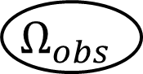

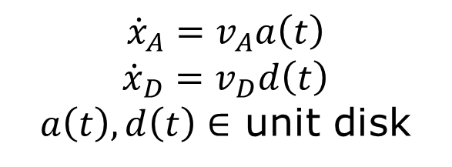

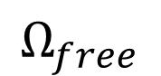
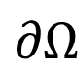

Two-Player Reach-Avoid Game
Target
obstacle
defender
attacker
$$∂Ω$$
$$Ω_{free}$$
$$D$$
$$Ω_{obs}$$
$$Ω$$
$$𝒯$$
$$A$$
$$Ω_{obs}$$
$${\dot{x}}_{A}=v_{A}a\left(t\right)$$
$${\dot{x}}_{D}=v_{D}d\left(t\right)$$
$a\left(t\right),d\left(t\right)∈$ unit disk
Notes:
where each team only has one player. In this case, the joint state space has 4 dimensions, and we can solve the problem using known approaches.

Slide 9
Two-Player Reach-Avoid Game
Hamilton-Jacobi-Isaacs (HJI) method^{1,2}
Computes winning regions for each player
4D computations, closed loop control
Path defense method
Approximates winning region for defender
2D computations, semi-open loop control
Tie together the pairwise solutions²
¹Huang et al. 2011
²Chen, Zhou, Tomlin ACC 2014
Notes:
One approach is the Hamilton-Jacobi-Isaacs approach, which solves the corresponding HJI PDE in 4D to compute a reachable set representing the winning region for each player under closed loop control.
In our present work, we will relax the above problem in order to do computations in a 2D space to obtain the approximate winning region for the defender given an attacker position. The defender uses a semi-open loop control, which means that the defender uses an open loop control some of the time, and a closed loop control the rest of the time.

Slide 10
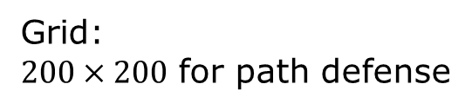
Path Defense Results: Defender Winning Regions
Grid:
$200×200$ for path defense
Notes:
The results we obtain, the approximate defender winning regions, are shown in these plots. Here, the target set is in green, the obstacles are in black. The given attacker position is shown as the red cross, example defender positions are shown in blue, and the approximate defender winning regions are shown in red. Any defender inside the winning region would be able to win against the attacker using a semi open loop control. For example, this attack wins against …
These winning regions can be interpreted as 2D slices of the 4D reachable sets that would be computed by solving an HJI PDE.

Slide 11
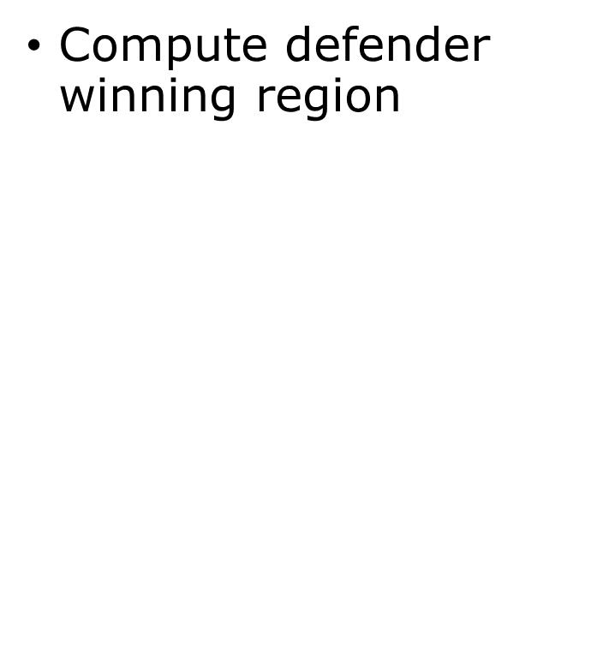

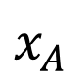
Relaxation: Path Defense
Compute defender winning region
Relaxations:
Defend a “path of defense” that encloses the target
Defend path by first moving to some point $p$ on the path
$$𝒯$$
$$x_{A}$$
Notes:
Next, we go into the details of the path defense approach.

Slide 12
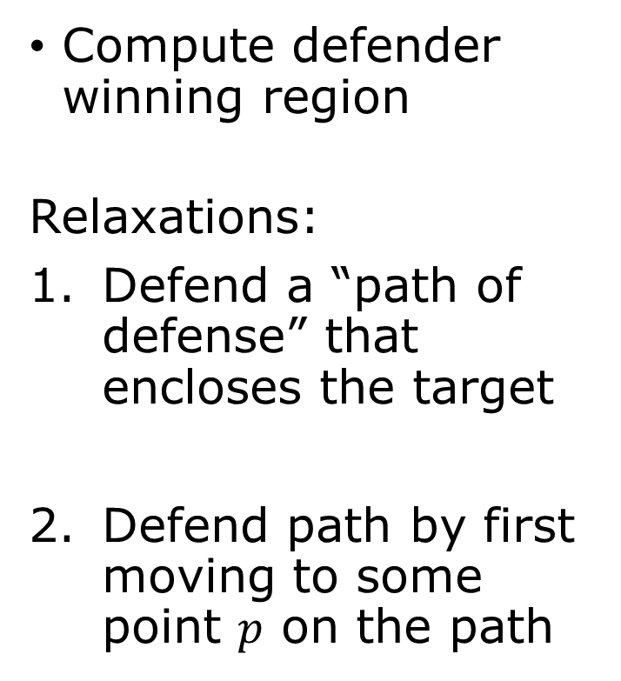

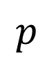
Relaxation: Path Defense
Compute defender winning region
Relaxations:
Defend a “path of defense” that encloses the target
Defend path by first moving to some point $p$ on the path
$$𝒯$$
$$p$$
$$x_{A}$$
Notes:
First, instead of defending the target, we defend a path of a defense that encloses the target. Second, we restrict the defenders to defend the path by first moving to some point p on the path, and then defend it.
It turns out that given these relaxing assumptions, we can perform computations in 2D instead of 4D

Slide 13
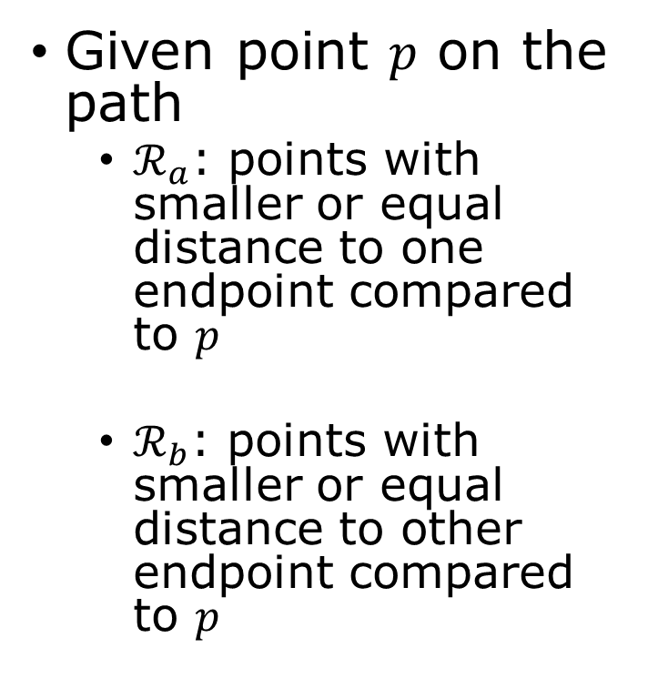
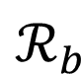
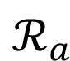
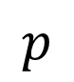
Relaxation: Path Defense
Given point $p$ on the path
$ℛ_{a}$: points with smaller or equal distance to one endpoint compared to $p$
$ℛ_{b}$: points with smaller or equal distance to other endpoint compared to $p$
$$𝒯$$
$$p$$
$$ℛ_{a}$$
$$ℛ_{b}$$
$$x_{A}$$
Notes:
With the previous assumptions, we now briefly discuss the conditions for the defender to defend the path. First, we now define the sets Ra, which is the set of points with smaller or equal distance to a boundary point compared to p. Rb is defined similarly with respect to the other boundary point.

Slide 14
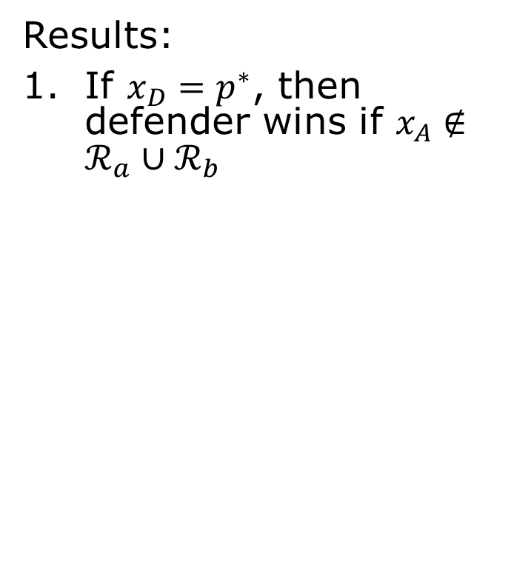
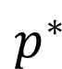
Relaxation: Path Defense
Results:
If $x_{D}=p^{∗}$, then defender wins if $x_{A}∉ℛ_{a}∪ℛ_{b}$
Defender’s best point of arrival is $p^{∗}$
$ℛ_{a},ℛ_{b}$ equidistant to $x_{A}$
Semi-open loop strategy for defender
All computations are 2D
Fast marching method⁴
$$𝒯$$
$$p^{∗}$$
$$ℛ_{a}$$
$$ℛ_{b}$$
$$x_{A}$$
Notes:
The results are as follows. If the defender starts on some point on the path, then the defender wins if the attacker is not in one of the induced regions. The proof is in the paper, but intuitively, outside of the induced regions, the attacker is too far away from the path to cross is without being captured.

Slide 15
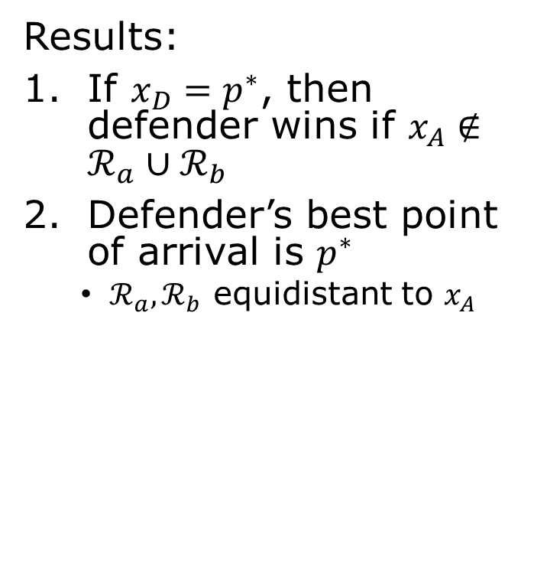
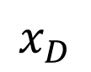
Relaxation: Path Defense
Results:
If $x_{D}=p^{∗}$, then defender wins if $x_{A}∉ℛ_{a}∪ℛ_{b}$
Defender’s best point of arrival is $p^{∗}$
$ℛ_{a},ℛ_{b}$ equidistant to $x_{A}$
Semi-open loop strategy for defender
All computations are 2D
Fast marching method⁴
$$𝒯$$
$$p^{∗}$$
$$ℛ_{a}$$
$$x_{D}$$
$$ℛ_{b}$$
$$x_{A}$$
Notes:
In general, the defender does not start on the path, but instead would need to choose a first-arrival point on the path, and then check whether the attacker is in the resulting induced regions. It turns out that there’s a best point of arrival, p^*, for the defender. This point is defined by the induced regions being equidistant to the attacker’s initial position. If the defender cannot defend the path by first going to p^*, then she would not be able to defend the path by going to any other point on the path. This is also proven in the paper.

Slide 16
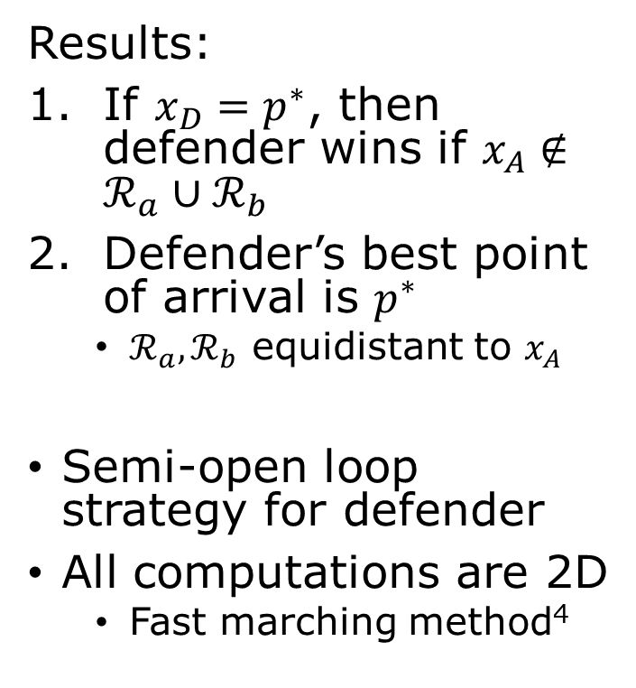
Relaxation: Path Defense
Results:
If $x_{D}=p^{∗}$, then defender wins if $x_{A}∉ℛ_{a}∪ℛ_{b}$
Defender’s best point of arrival is $p^{∗}$
$ℛ_{a},ℛ_{b}$ equidistant to $x_{A}$
Semi-open loop strategy for defender
All computations are 2D
Fast marching method⁴
$$𝒯$$
$$p^{∗}$$
$$ℛ_{a}$$
$$x_{D}$$
$$ℛ_{b}$$
$$x_{A}$$
⁴Sethian, 1996
Notes:
If the defender is able to defend the path, then she would adopt a semi-open-loop strategy to defend it: first, the defender moves to p^*; this is the open-loop part. Then, the defender would move along the path in response to the attacker’s movements.
The computation of the regions involved are all based on distance, and thus the 2D fast marching method can be used.

Slide 17
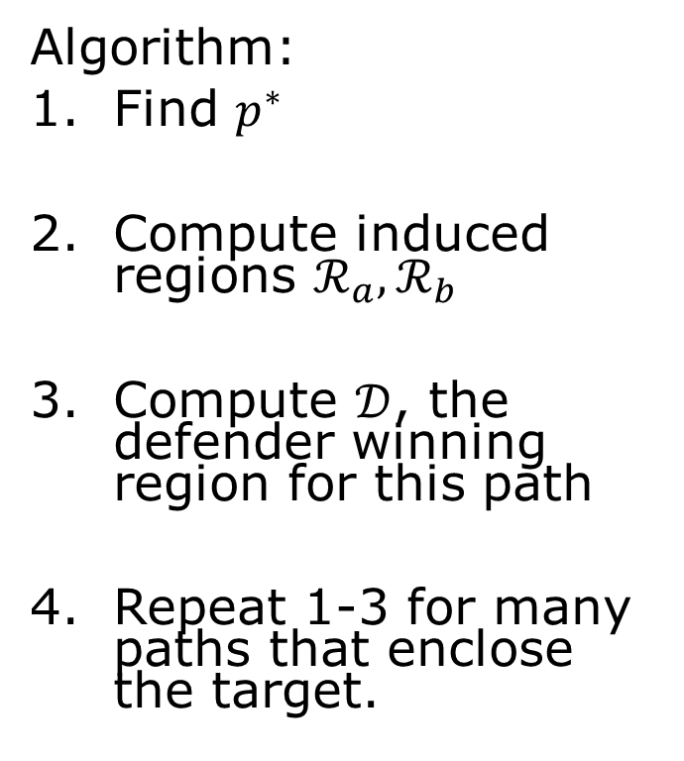
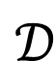
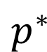
Relaxation: Path Defense
Algorithm:
Find $p^{∗}$
Compute induced regions $ℛ_{a},ℛ_{b}$
Compute $𝒟$, the defender winning region for this path
Repeat 1-3 for many paths that enclose the target.
$$𝒯$$
$$𝒟$$
$$p^{∗}$$
$$ℛ_{a}$$
$$ℛ_{b}$$
$$x_{A}$$
Notes:
To summarize, the algorithm for determining whether a path can be defended using the semi-open-loop strategy is as follows. First, find p*. Then, compute the induced regions Ra and Rb. Next, compute the winning region for this path, which would be the points that are closer to p* than the attacker is to the induced regions.
The size of the region would scale linearly with the relative speeds of the defender, so that one such computation takes into account all defender maximum speeds.
Finally, we can repeat these steps to check many different paths that enclose the target set.

Slide 18
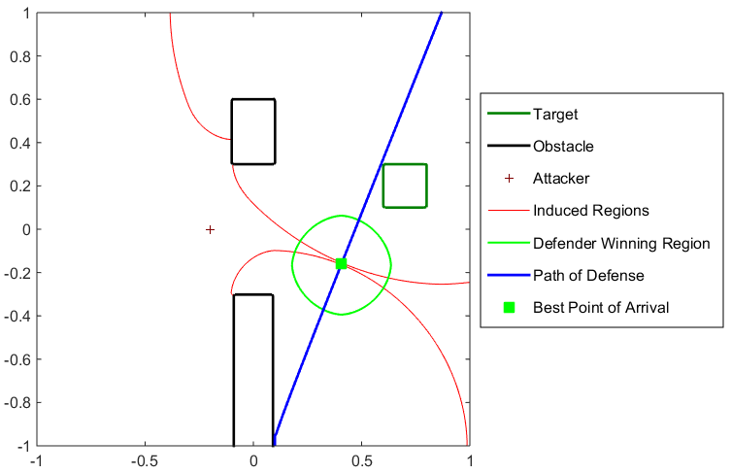
Relaxation: Path Defense
Grid: 200x200
Notes:
This plot shows the relevant regions on a matlab plot. The black squares are obstacles, the green square is the target set; the red cross is the attacker, and the blue line is the path that encloses the target set. If the defender starts inside the green region D, then she would be able to move to p*, the green square, before the attacker gets into Ra union Rb, the red regions.

Slide 19
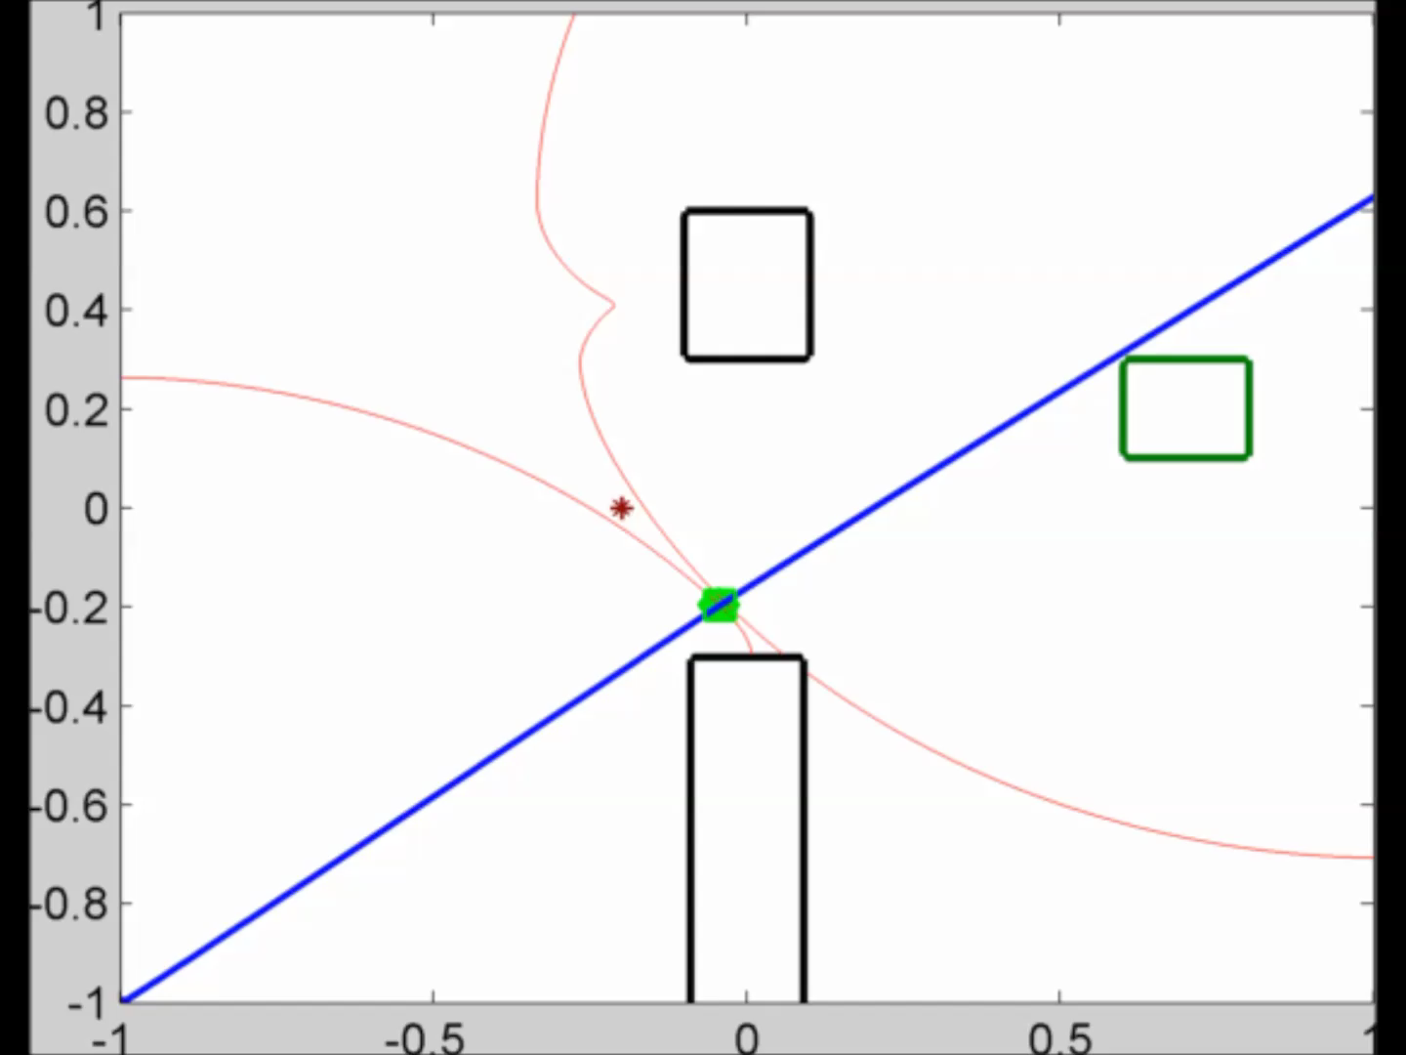
Relaxation: Path Defense
937 paths
Notes:
We can now perform the winning region for different paths, and then take the union of them to approximate the defender winning region. We only consider paths that touch the target set, and this does not introduce any additional conservatism in a simply-connected domain.
This video shows the winning regions for 937 different paths that enclose the target. Taking the union of these regions, we obtain an approximation of the 2D slice of the 4D reach-avoid set.

Slide 20
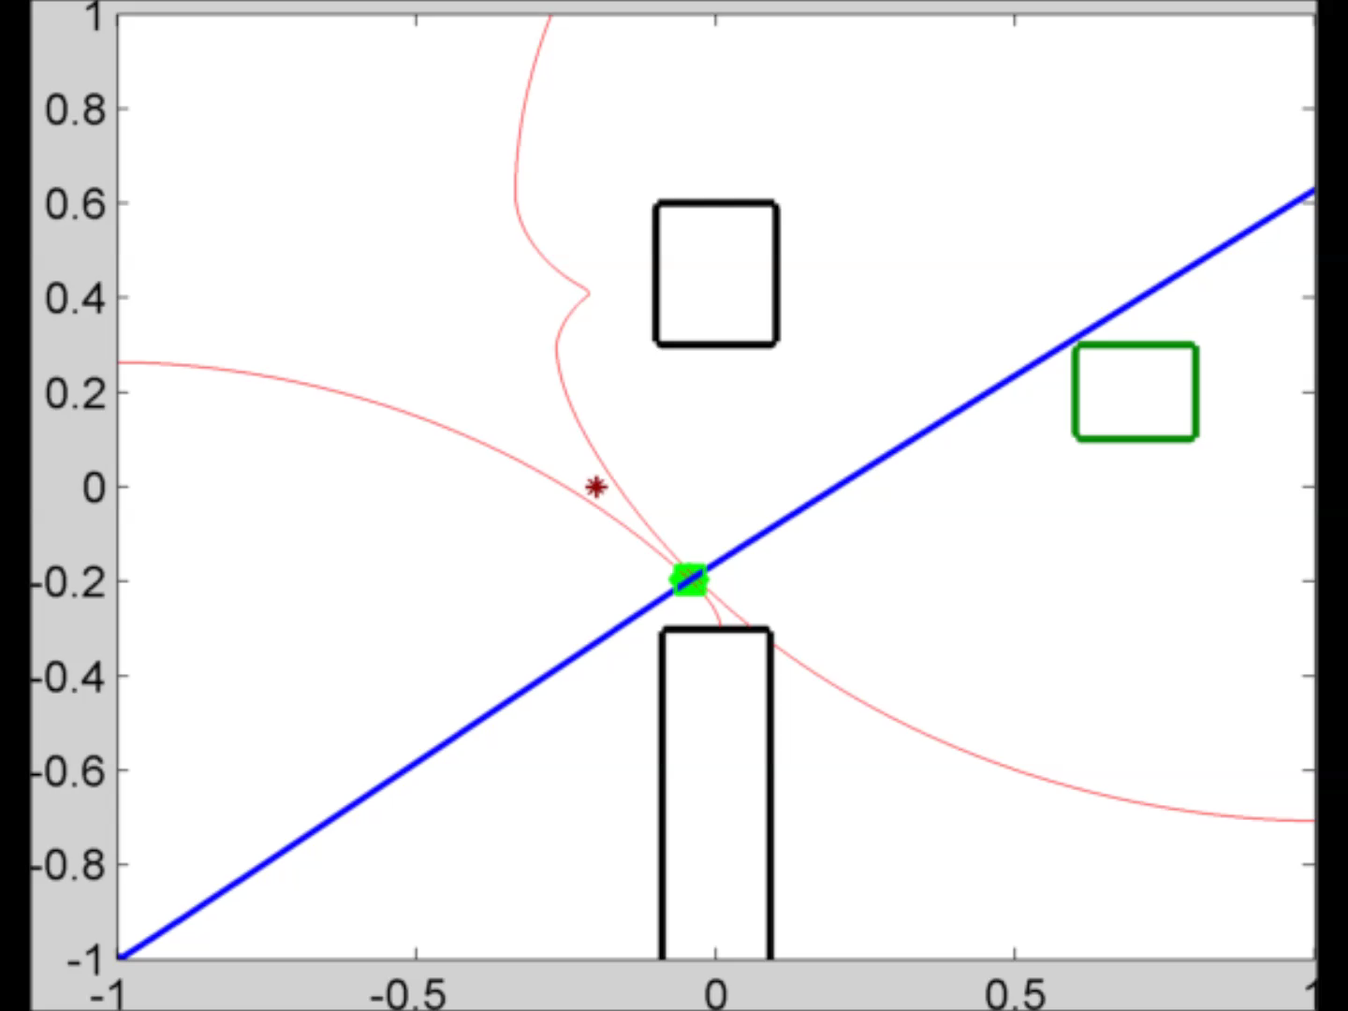
Number of paths
117 paths
Notes:
We can choose the number of paths to check. With fewer paths, we would be taking the union of fewer winning sets, making the approximation to the 2D slice more conservative. Here’s the same video for 117 paths and 29 paths.

Slide 21
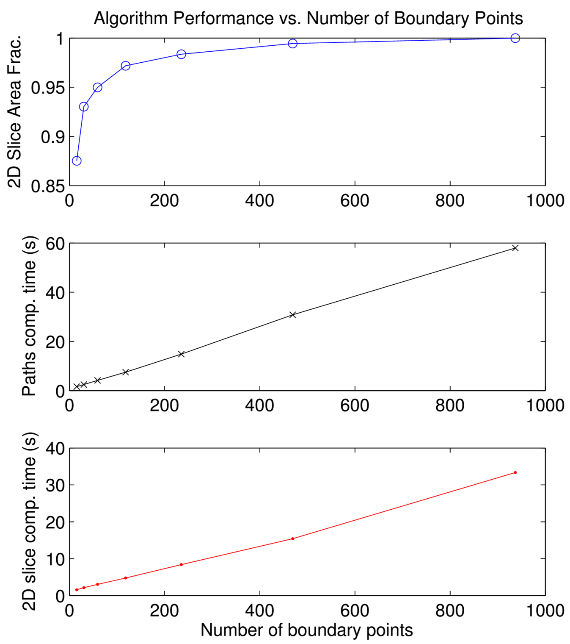
Number of paths
Grid: 200x200
Notes:
These plot summarizes the result of using different numbers of paths. The top plot shows the fraction of area covered compared to using 937 paths. As you can see, very few paths are needed to cover a large fraction of the area. The second plot shows computation time, which grows linearly with the number of paths as expected. To cover 95% of the area compared to using 937 paths, one could use only about 50 paths, and the computation would be done in about 3 seconds. For comparison, solving a 4D HJI PDE on a much coarser grid takes about 30 minutes.

Slide 22
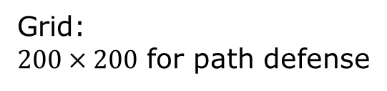
Path Defense Results: Defender Winning Regions
Grid:
$200×200$ for path defense
Notes:
Now, we arrive again at the results we have seen before, the defender winning regions given the attacker position. Any defender inside the red boundary would be able to win against the attacker shown in each plot. Note that our conservatism is towards the defenders; the defender is guaranteed to win against the attacker if he’s inside the red boundary. If the defender is outside of the red boundary, he may or may not be able to win against the attacker.

Slide 23
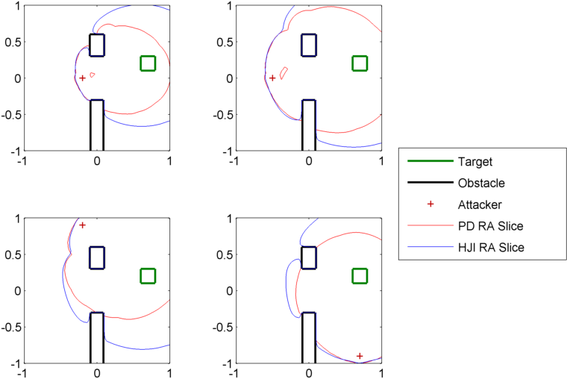
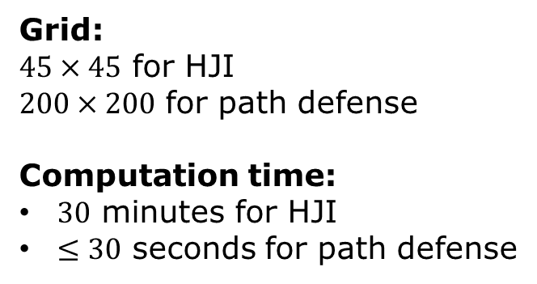
Results: HJI vs. Path Defense
Grid:
$45×45$ for HJI
$200×200$ for path defense
Computation time:
$30$ minutes for HJI
$≤30$ seconds for path defense
Notes:
Finally, these plots compare winning regions computed using the HJI approach (shown in blue) and using the path defense approach (shown in red). As expected, the path defense results are conservative towards the defender, but still guarantees that the target set will be able to be defended.
However, with the relaxations in the path defense approach, we have reduced the computation time from about 30-minutes on a coarse grid to on the order of seconds on a much finer grid.

Slide 24
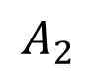
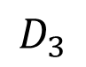
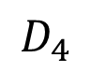
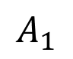
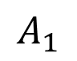
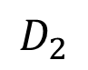











From Two Player to Multiplayer
HJI two-player solution:
$N^{2}×4$D HJI PDEs need to be solved in general
Path defense two-player solution:
$O\left(N\right)×2$D path defense computations
$$A_{1}$$
$$D_{1}$$
$$A_{1}$$
$$D_{1}$$
$$A_{2}$$
$$D_{2}$$
$$A_{2}$$
Maximum matching
$$D_{2}$$
$$A_{3}$$
$$D_{3}$$
$$A_{3}$$
$$D_{3}$$
Two player solutions
$$A_{4}$$
$$D_{4}$$
$$A_{4}$$
$$D_{4}$$
Notes:
To go from the two player game to the multiplayer game, we first obtain all pairwise solutions between an attacker and a defender. This can be done by solving N^2 HJI PDEs in general, one for each defender-attacker pair, or only performing order N path defense computations.
The pairwise results would result in a bipartite graph, in which each edge represents a situation in which the defender can win against the attacker in a 1 vs. 1 situation. Then, a maximum matching of the graph would indicate the optimal way that the defenders can pair up with the attackers. In the illustration, if the defenders pair up with the attackers in the way shown, then they can guarantee that no attacker is able to reach the target.
In general, if there’s no perfect matching, the defenders would guarantee an upper bound on the attackers that can reach the target.

Slide 25
Maximum Matching Results
Notes:
This plot shows the bipartite graph in thin blue and maximum matching in thick dashed blue in a simulation. In this case, we have a 4 vs. 4 game in which the maximum matching is of size 3, meaning that at most one attacker will be able to reach the target.

Slide 26

Conclusion
HJI: $1×4N$D (Direct analysis)
HJI: $N^{2}×4$D
(Pairwise analysis, closed loop control)
Path defense: $O\left(N\right)×2$D
(Pairwise analysis, semi-open loop control)
Notes:
In conclusion, we started off with a very high dimensional problem, 4ND. In our previous work, using the 4D two-player solutions as a unit problem, we can make the original problem tractable. Now, in our new work, by relaxing the unit problem, we can make the computation much more efficient and scalable, while still maintaining guarantees for the defending team.

